Slide 1

FOSB WG Metadata & Standardization
2021-05-25

Slide 2
Agenda
Update Roadmap
State of affairs TF Metrics
State of affairs TF DMP
Questions on implementation of FOSB metadata model
AoB

Slide 3
FOSB WG Metadata & Standardization roadmap
..\..\roadmap_aantepassen.pdf
Roadmap WG RDM & OS p. 6-7
Roadmap WG Architecture p. 9-10
Updated roadmap - Deadline: June 15th, 2021

Slide 4
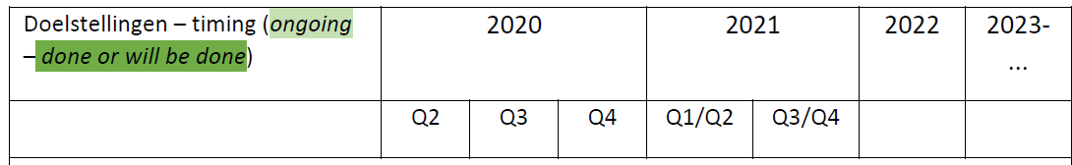
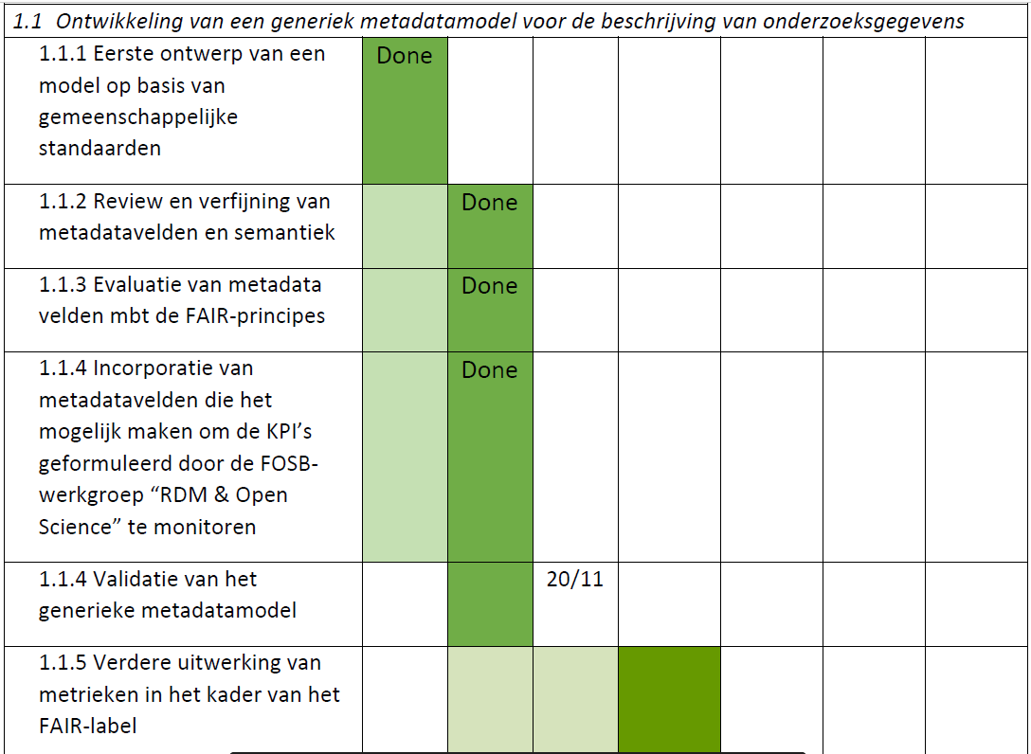
Generic metadatamodel

Slide 5
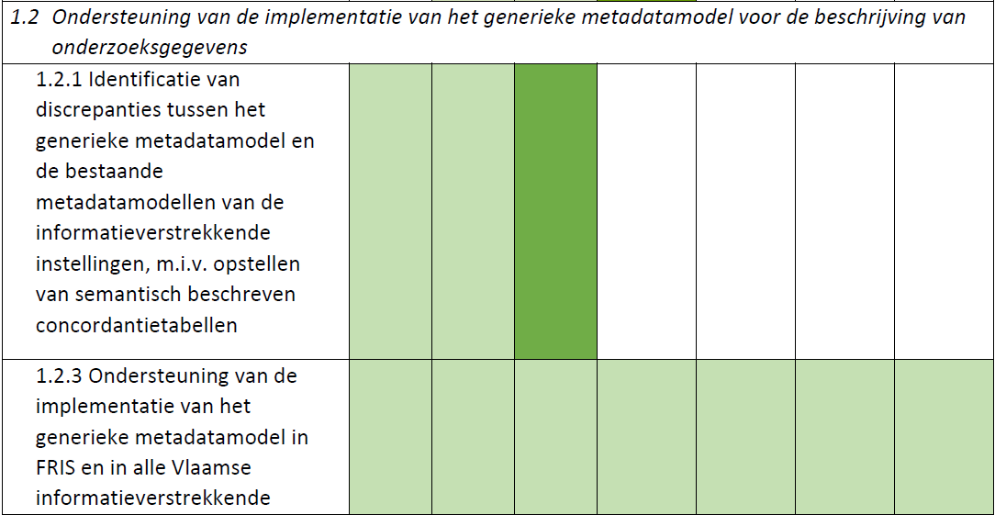
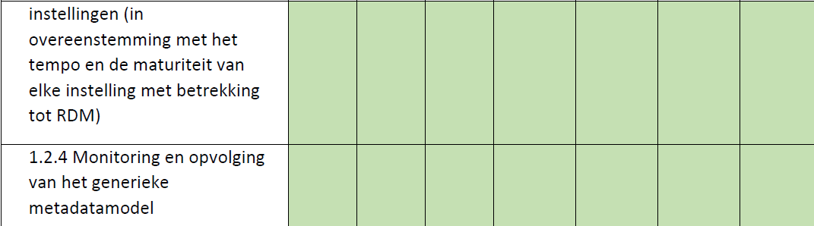
2020
Q4
2022
Q1/Q2
2022
Q3/Q4
2022
2023

Slide 6
FOSB WG Metadata & standaardisation
Generic metadatamodel:
1.1 Development
Incorporation of metadata fields that make it possible to monitor the KPIs formulated by the FOSB-WG "RDM & Open Science
Further development of metrics within the framework of the FAIR label
Timing:Q3/Q4 2021
1.2 Support upon implementation
Supporting the implementation of the generic metadata model in FRIS and in all Flemish information-providing institutions (in accordance with the pace and maturity of each institution with regard to RDM)
Monitoring and follow-up of the generic metadata model
Timing: Q3/Q4 2021, 2022

Slide 7
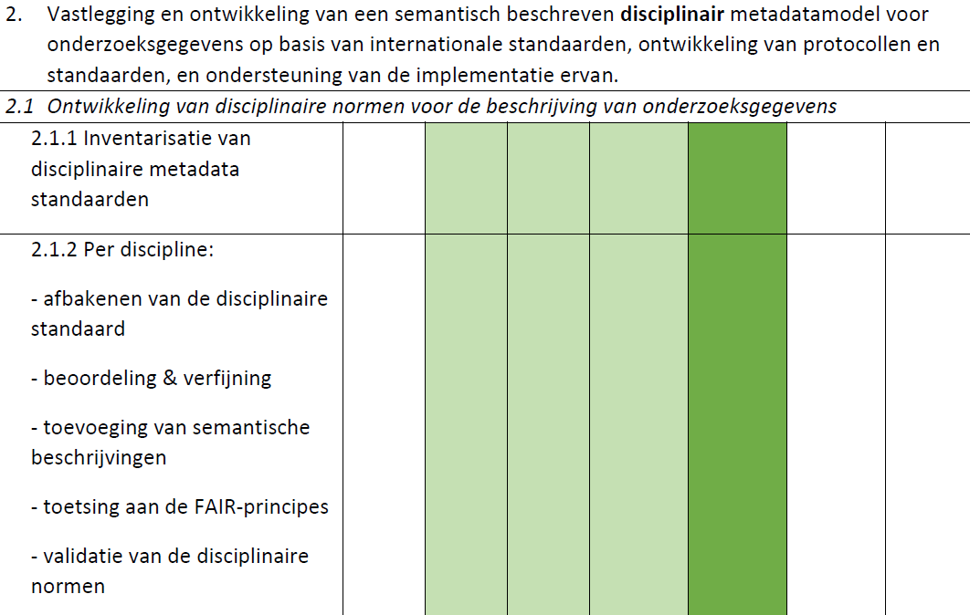
Disciplinary metadatamodel
2022
Q1/Q2
2022
Q3/Q4
2022
2023

Slide 8
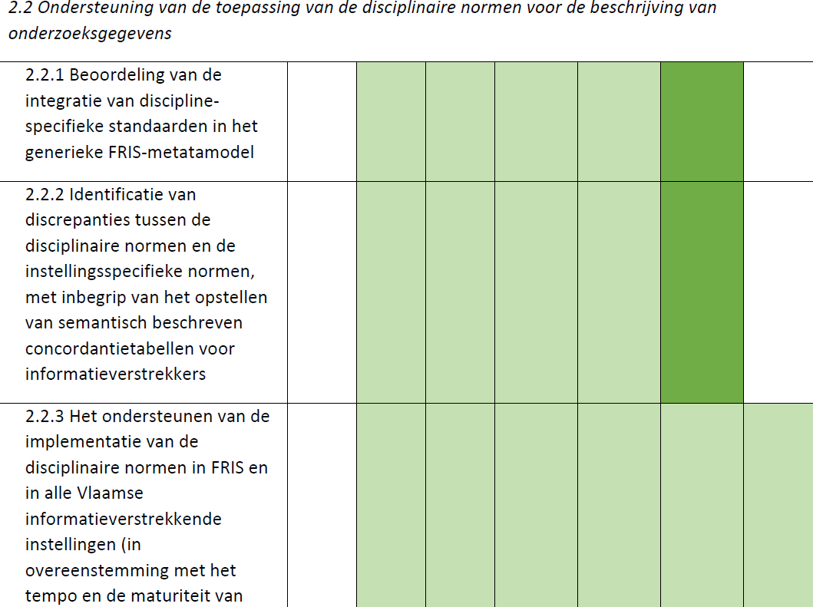
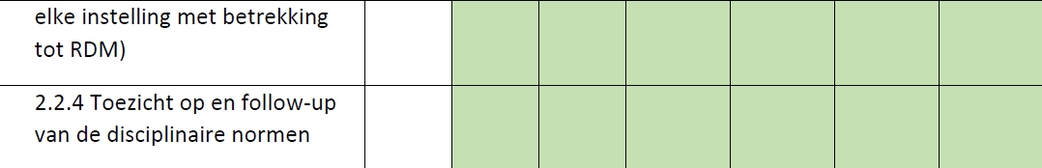
2022
Q1/Q2
2022
Q3/Q4
2022
2023

Slide 9
FOSB WG Metadata & standaardisation
Disciplinary metadatamodel:
Development
Timing: Q3/Q4 2021 en 2022
Implementation
Timing: 2023
→ Broader description based on Vision/Mission?

Slide 10
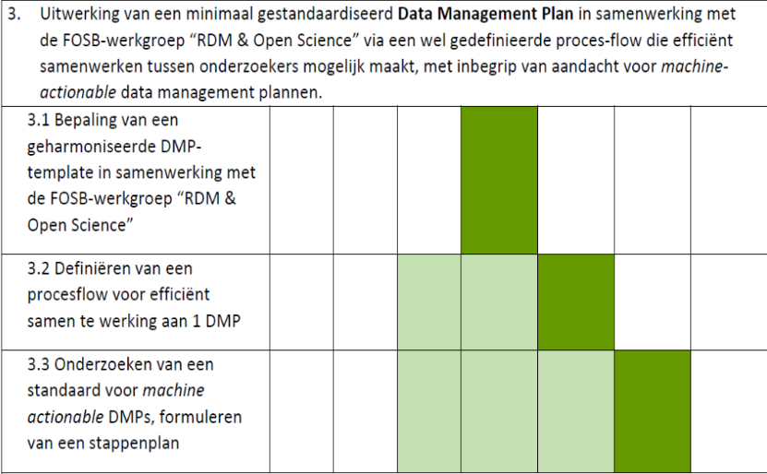
MEDEDELING AAN DE VLAAMSE REGERING: Open Science beleid in Vlaanderen: roadmap, KPI’s en meerjarenplan p. 15
2021
Q1/Q2
2021
Q3/Q4
2022

Slide 11
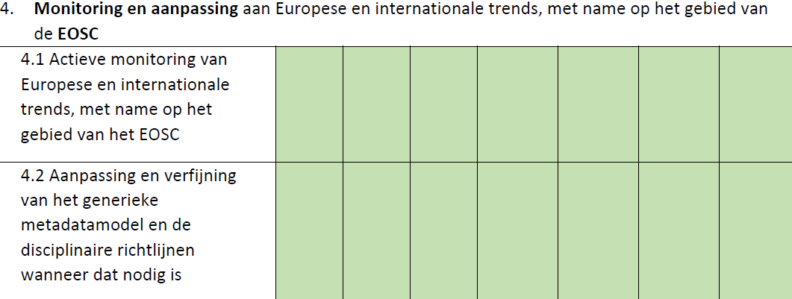
2022
Q1/Q2
2022
Q3/Q4
2022
2023

Slide 12
FOSB WG Metadata & standaardisation
Data Management Plan:
Development DMP
Timing: Q3/Q4 2021
Development proces flow
Timing: 2022
Development roadmap MaDMPs
Timing: 2022/2023
EOSC Association
Bidirectional monitoring of EU Policy and advices
Semantic and technical interoperability
Timing: continuous

Slide 13
FOSB WG Metadata & standardization
Other strategic, operation goals or actions:
Installing a data governance structure
Ameliorating outreach
Stimulating collaboration efforts amongs WGs
Other?
Based on discussions on the FOSB Vision/Mission

Slide 14
Agenda
Update Roadmap
State of affairs TF Metrics
State of affairs TF DMP
Questions on implementation of FOSB metadata model
AoB

Slide 15
State of affairs TF Metrics
Metrics for Open Science KPIs
FAIR data label for datasets
Open data
Timing
Q1 2021: proposal FAIR label
Q3 2021: proposal Open Data label
Q4 2021: rules FA
2022: rules FAIR
2023 implementation FAIR & Open data label

Slide 16
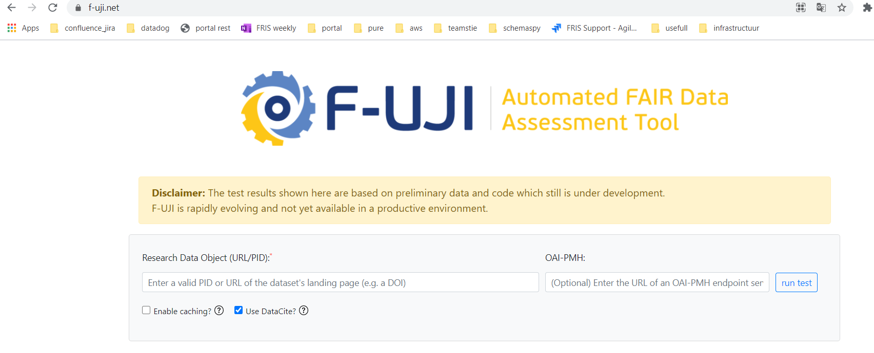
FAIRsFAIR F-UJI
3th party, open source solution (funded till march 2022)
Search on Persistent identifer
With/without OAI-PMH
With/without DataCite
Example : doi:10.1594/PANGAEA.269656 in the next slides
https://www.f-uji.net/

Slide 17
Summary
Advantages | Disadvantages
Can be calculated based on Persistent identifier | Needs to run somewhere, so infrastructure is needed
Supports multiple Persistent identifiers (Doi, handle) | Not sure if maintened after march 2022
REST-API provided | Score is different depending on the information we can provide to the tool
Objective 3th party tool
Open source: metrics can be adapted No development cost
Supported by European project
FAIR label for data and metadata is calculated
Performance is ok
Answers to our needs
Note: if funding continues a REST-api might be provided (1st and 2nd disadvange is then not valid anymore)

Slide 18
Agenda
Update Roadmap
State of affairs TF Metrics
State of affairs TF DMP
Questions on implementation of FOSB metadata model
AoB

Slide 19

MEDEDELING AAN DE VLAAMSE REGERING: Open Science beleid in Vlaanderen: roadmap, KPI’s en meerjarenplan p. 15
2021
Q1/Q2
2021
Q3/Q4
2022

Slide 20
State of affairs TF DMP
M1: Create a minimal standard DMP template (theme, questions & answers).
List of Core (sub)topics
RDM-stewards: feedback FWO DMP user perspective
Draft Flemish minimum standard DMP
Target: Q3 2021
M2: Map modalities for adding a PID to DMPs, preferably a DOI
Target: Q2/Q3 2021
M3:Propose a standard for machine-actionable DMPs in the future.
Target: 2022

Slide 21
Agenda
Update Roadmap
State of affairs TF Metrics
State of affairs TF DMP
Questions on implementation of FOSB metadata model
AoB

Slide 22
Questions upon metadatamodel implementation
Version 2020-11-20_FOSB_metadatamodel_V1.7ter
Implementation in FRIS is ongoing: a few concretisations are proposed
Concretisations:
Column with multiplicity (1-n relations)
Identifiers:
Multiplicity: max 1 DOI; other identifier types?
URL:
Specific enough to identify a dataset?
Can the identifier type in FRIS “Institional Repository URL” be used for URL?
Should URL be excluded from the aliasing of identifiers in FRIS?
Main identifier: will be the first of the identifiers in the following order:
DOI>Handle>ARK>PURL>(Instititutional Repository) URL>URN

Slide 23
Priority rank for determining the Main Identifier:
Rank | Identifier | Allowed more than once
1 | DOI | No
2 | Handle | Yes?
3 | ARK | ?
4 | PURL | ?
5 | (Institutional Repository) URL | Yes
6 | URN | ?

Slide 24
Questions upon metadatamodel implementation
Abstract & Description
Multilanguage field?
Descriptiontypes not to be passed on separately
Title
Multilanguage field?
Publisher
Mandatory in OpenAIRE. Also in Flanders?
PublicationYear
Date possible?
In case of embargo => PublicationYear = EmbargoYear
Format
Free tekst, multiple values possible
Lowercase without punctuation marks
Open format toggle
Derived from list formats & open/closed, delivered by ECOOM after formal agreement in FOSB WG Metadata & Standardization
Not to be provided by the institutions

Slide 25
Questions upon metadatamodel implementation
Licenses
> 1 license possible?
Legitimate opt-out clarification
1 per opt-out or 1 per dataset?
Link to Project(s)
Classifications
Link to Publication
Classifications
Link between datasets
Added
Classifications
Link to Infrastructure
Added
Classifications

Slide 26
Relation type
Is cited by / cites Publication, Project
Is supplement to / is supplemented by Publication, Project
Is continued by / continues Dataset
Is described by / describes
Has Metadata / is metadata for
Has version / is version of (Dataset)
Is new version of / is previous version of (Dataset)
Is part of / has part Dataset
Is referenced by / references Publication, Project
Is documented by / documents
Is compiled by / compiles Infrastructure
Is variant form of / is original form of / Is identical to
Is reviewed by / reviews
Is derived from / is source of Dataset
Is required by / requires
Obsoletes / is obsoleted by
Notes:
https://support.datacite.org/docs/schema-optional-properties-v43#12-relatedidentifier

Slide 27
Questions? Suggestions? ECOOM@uhasselt.be
Sadia Vancauwenbergh, Evy Neyens
Ils De Bal, Pascale Dengis, Jochen Deferme

Slide 28
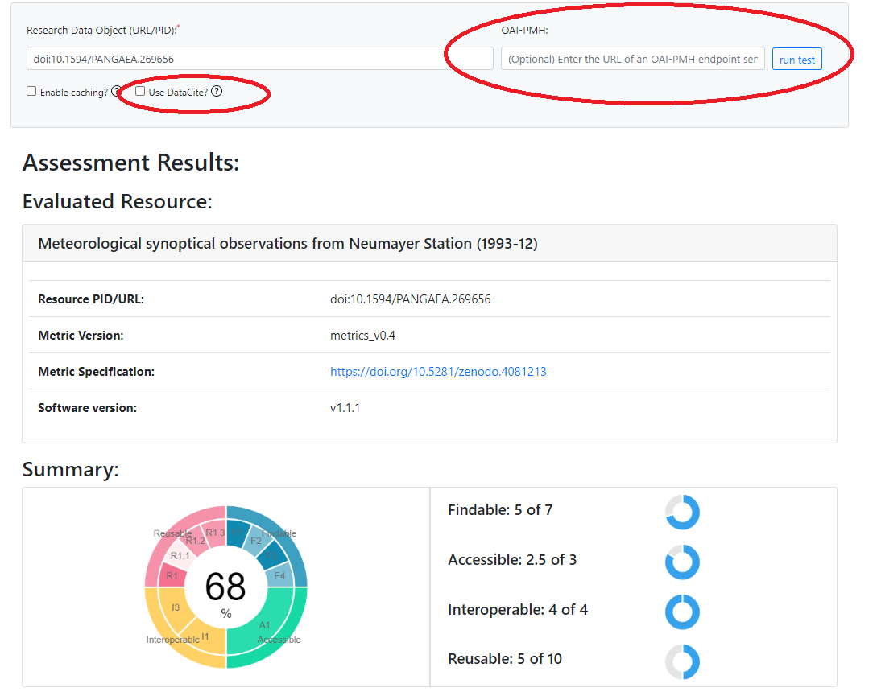
Example: search on DOI

Slide 29
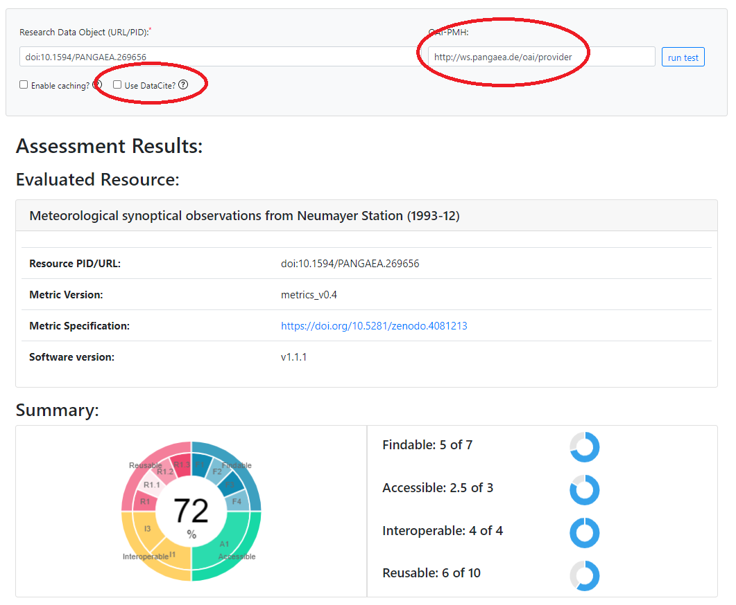
Example: search on DOI + OAI-PMH

Slide 30
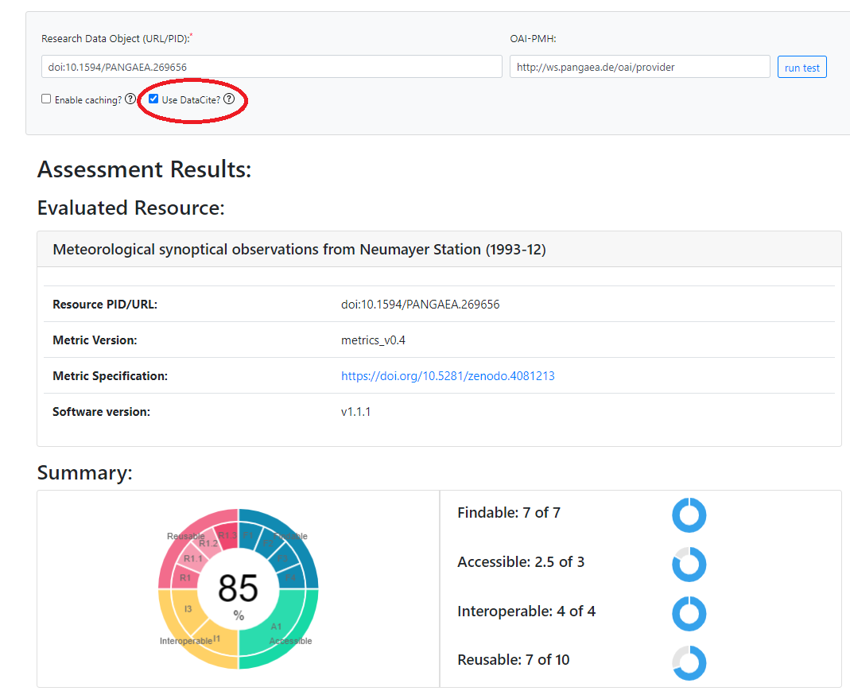
Example: search on DOI + Datacite (+ OAI-PMH)

